Slide 1

CSE 6389-001: Special Topics in Advanced Multimedia, Graphics, & Image Final Project
Flyn Sequeira, Shivam singh
University of Texas at Arlington
Instructor: Dr. Dajiang Zhu
Department of Computer Science and Engineering

Slide 2
What have we learned?
Identifying tech through research papers.
Understand cutting edge methods and algorithms in Deep Learning and how it can be improved.
Familiarized with how the Brain works and research in Brain Image processing.
Importance of Clinical studies.
Developing a sense of Disciplinary Literacy and realizing its importance.
And finally, we have built a confidence to get into research and present a paper in future.

Slide 3
What have we learned?
Learnings from the paper assigned to me: “Cortical graph network for AD and mci diagnosis and transfer learning across populations”
Without research, there is no science; but without communication, research would grind to a halt.
Learned about the Spectral Graph CNN.
Learned about the importance of Transfer learning.
Importance of Cortical Thickness and its underlying geometric information for AD and MCI diagnosis and MCI-to-AD conversion.
Time long efforts by the researchers proposed a spectral graph-CNN model in this study which is relatively general and can be applied to other brain imaging data for the early diagnosis of brain disorders.
Great efforts by ADNI by collecting, maintaining and providing data.

Slide 4
What have we learned?
Understanding the intricacies of Brain Imaging and fMRI data.
We have understood how fMRI data can be represented in various ways using various techniques
E.g. In the paper I presented we use collaborative sparse brain decomposition model to extract functional signatures from fMRI data

Slide 7
What have we learned?
In depth understanding of how LSTM was modelled to distinguish subtle brain states.
LSTM has an inherent nature of understanding temporal data
We used LSTM and compared the results with CNN to demonstrate the power of either, with the temporal fmri dataset.

Slide 8
dataset
Temporal fMRI Dataset which has 150 regions of interest which are the features.
The dataset timesteps came in 3 ranges – 134, 191, 194
But this was true only for Patient Dataset, all healthy dataset were 191
Possible Reason for this – Many patients would have not had fMRI dataset after their demise.
We cropped every subject’s timestep at 134.

Slide 9
Deep learning architectures used
CNN
LSTM
Combined architecture of 1D-CNN followed by LSTM

Slide 10
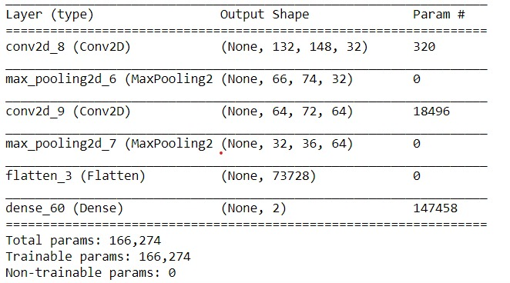
Deep learning architectures: CNN

Slide 11
Deep learning architectures: CNN
code

Slide 12
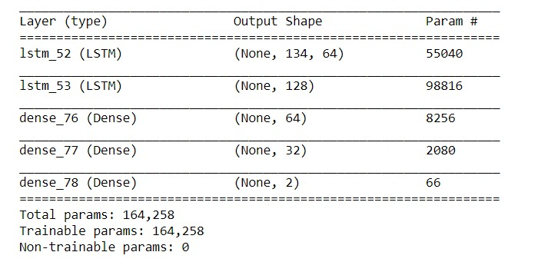
Deep learning architectures: lstm

Slide 13
Deep learning architectures: lstm
Code

Slide 14
Combined architecture: cnn with lstm

Slide 15
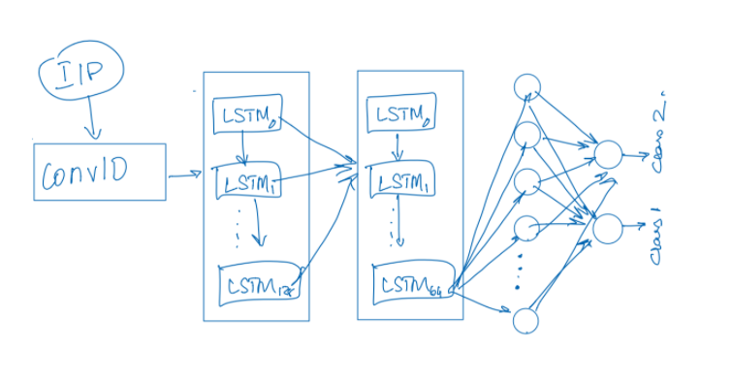
Combined architecture: cnn with lstm

Slide 16
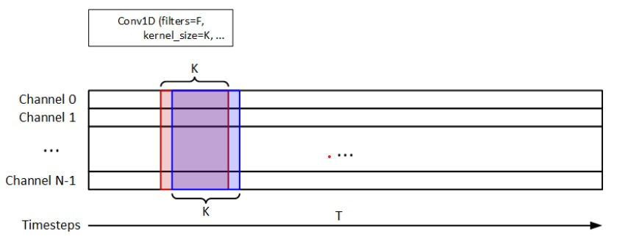
Combined architecture: cnn with lstm

Slide 17
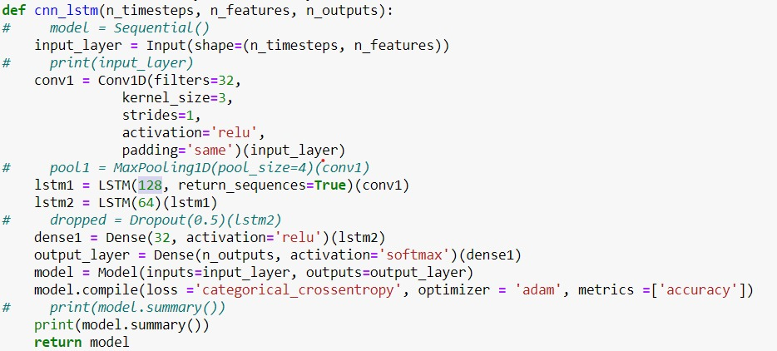
Combined architecture: cnn with lstm

Slide 18
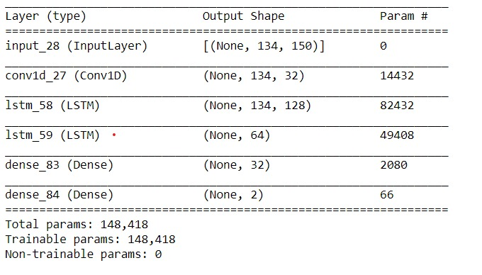
Combined architecture: cnn with lstm

Slide 19
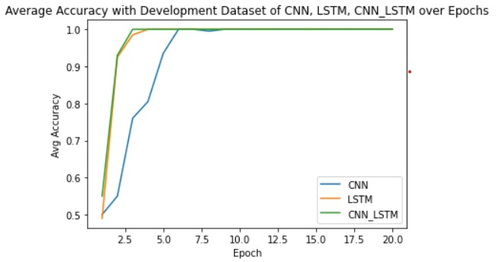
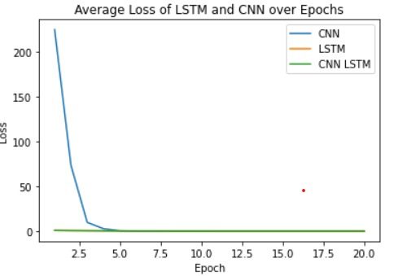
Performance comparisons: CNN, LSTM and CNN with LSTM

Slide 20
Results

Slide 21
CONCLUSION
We find out that using a combination of 1D CNN and LSTM gives the best results.
One possible approach that can be tried is to perform filtering across the channels, but by this we aren’t extracting features from the temporal dimensions.
CNN seems to perform the poorest among the experiments, as it is not inherently acquiring temporal data

Slide 22
Suggestions about the course
A tutorial lecture to develop a modus operandi for achieving a rapid, purposeful, effective and useful method to read these research papers.
Explaining how to look for intricacies in a good research paper, for Master’s students.
E.g. how to read and make the best out of the mathematics in it?
A demo on how to implement a paper into code.

